Slide 1
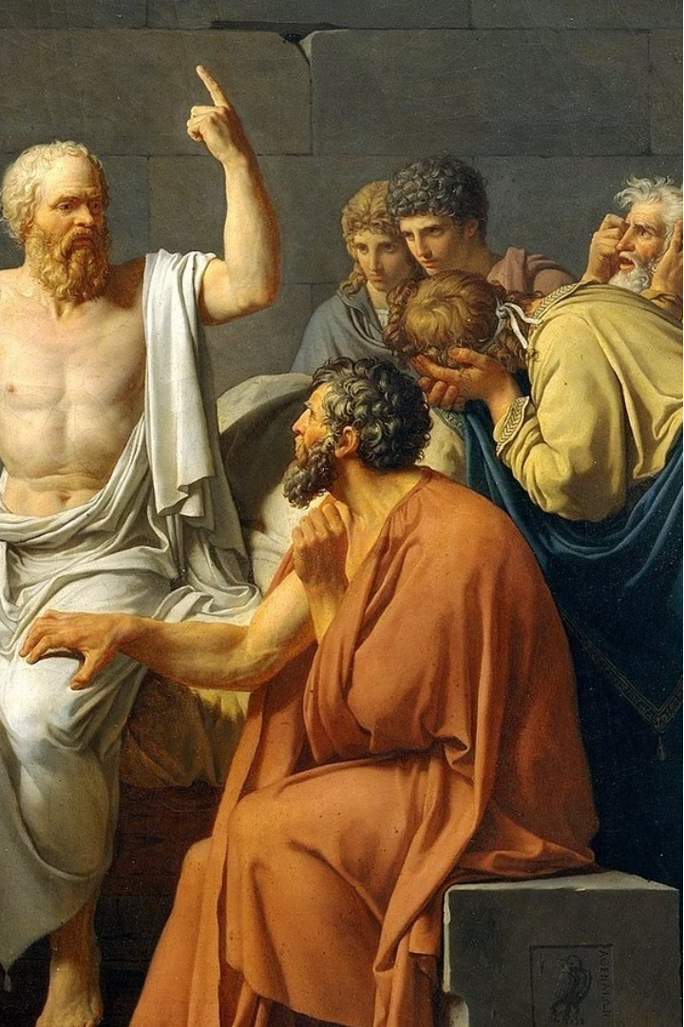
Empedocles and the Elements of the Universe
Empedocles was a pre-Socratic philosopher who lived in ancient Greece. He proposed that the universe was composed of four fundamental elements: earth, air, fire, and water. These elements were driven by the opposing forces of love and strife, which governed the cyclical nature of existence.

Slide 2
The Four Classical Elements
Earth
Air
Solid, stable, and grounded, representing the physical world.
Invisible, flowing, and ever-changing, representing the realm of ideas and thoughts.
Fire
Water
Energetic, transformative, and purifying, representing passion and spirit.
Fluid, adaptable, and life-giving, representing the cycle of birth, death, and rebirth.

Slide 3

The Forces of Love and Strife
Love
1
The binding force that draws the elements together, creating harmony and unity.
2
Strife
The divisive force that separates the elements, leading to change and disintegration.
The Cycle
3
The interplay of love and strife drives the cyclical nature of existence, constantly transforming the universe.

Slide 4




The Cyclical Nature of Existence
Birth
Growth
Decay
Death
The coming together of the elements under the influence of love.
The flourishing and development of the created entities.
The separation of the elements under the influence of strife.
The dissolution of the created entities, leading to a return to the cycle.

Slide 5
Reincarnation and the Transmigration of Souls
Reincarnation
Transmigration
Purification
Empedocles believed in the concept of reincarnation, where the soul or essence of a being is reborn into a new form.
The soul could move between different types of beings, including humans, animals, and even plants, as part of the cyclical nature of existence.
The cycle of reincarnation was seen as a process of purification, where the soul could eventually reach a state of harmony and unity with the cosmos.

Slide 6

Empedocles' Influence on Early Western Philosophy
1
Pre-Socratic Thought
2
Pluralism
3
Cyclical Worldview
Empedocles was a pioneering figure in pre-Socratic philosophy, laying the groundwork for later thinkers.
His concept of the four elements as the fundamental building blocks of the universe influenced the development of pluralist philosophical thought.
Empedocles' ideas about the cyclical nature of existence and the role of love and strife shaped early perspectives on the origins and development of the cosmos.

Slide 7



Empedocles and Modern Scientific Thought
Elemental Theory
Thermodynamics
Ecology
Empedocles' concept of the four elements anticipates the modern understanding of the periodic table and the fundamental building blocks of matter.
His ideas about the cyclical nature of existence and the opposing forces of love and strife resonate with the principles of thermodynamics and the conservation of energy.
Empedocles' holistic view of the universe as a interconnected system of elements and forces influenced the development of modern ecological thought.

Slide 8
The Enduring Legacy of Empedocles
Philosophical Influence
Empedocles' ideas laid the foundation for the development of Western philosophy, inspiring later thinkers like Plato and Aristotle.
Scientific Insights
His conceptual framework anticipated modern scientific concepts, from the periodic table to thermodynamics and ecology.
Holistic Worldview
Empedocles' vision of the universe as a dynamic, interconnected system continues to resonate with contemporary holistic and systems-based approaches.

